Slide 1
The New SAGE Test Student Assessment of Growth And Excellence
All you need to know to be successful…
Bring Your Own Brain!

Slide 2
Signing In…

Slide 3
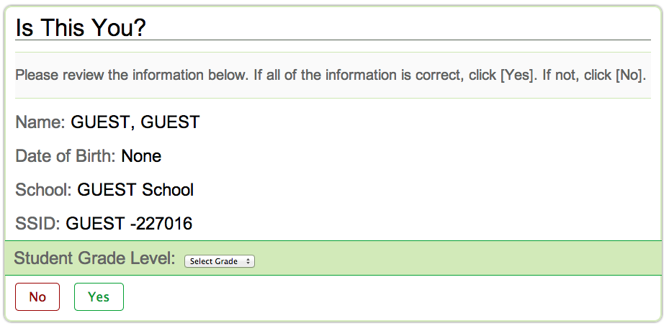

Slide 4
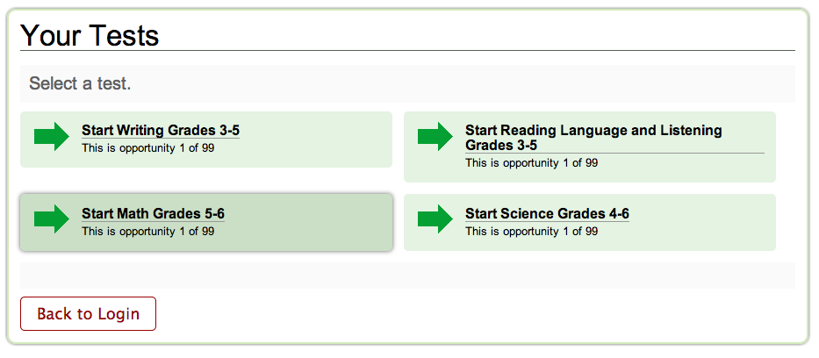

Slide 5
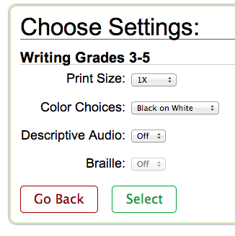

Slide 6
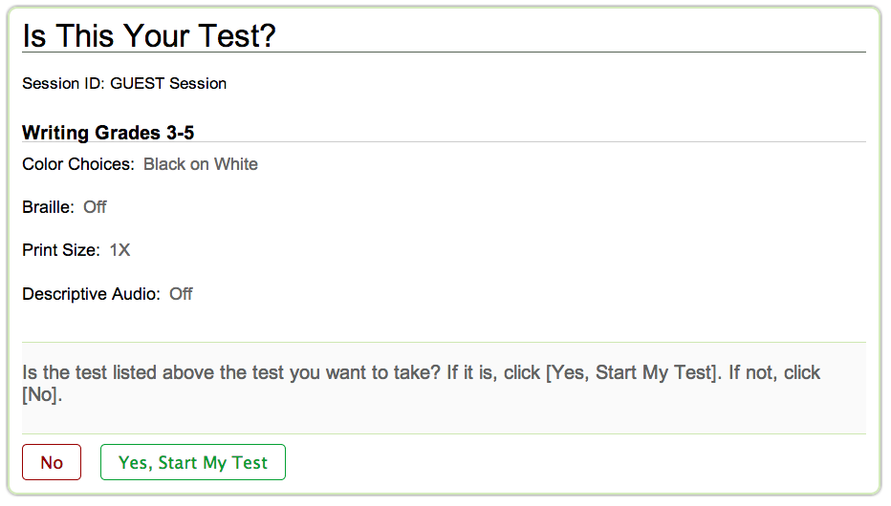

Slide 7
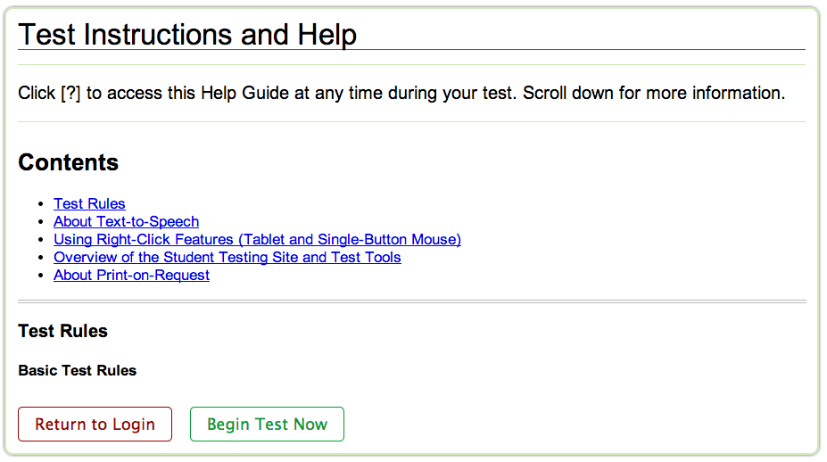

Slide 10
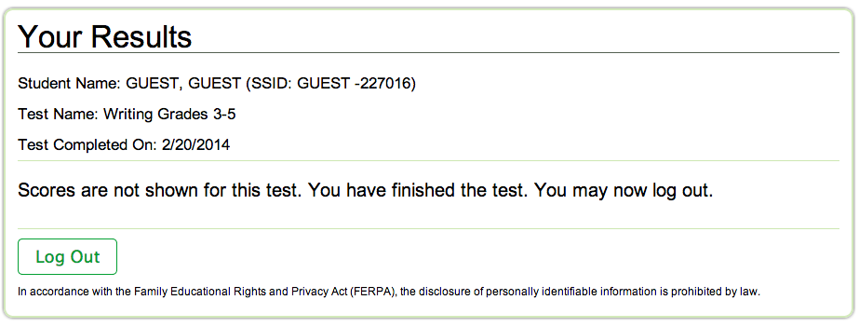

Slide 12
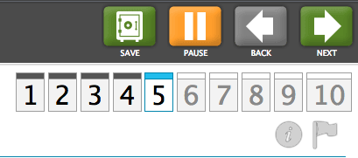
Navigation Tools!

Slide 13
The Math Test

Slide 14
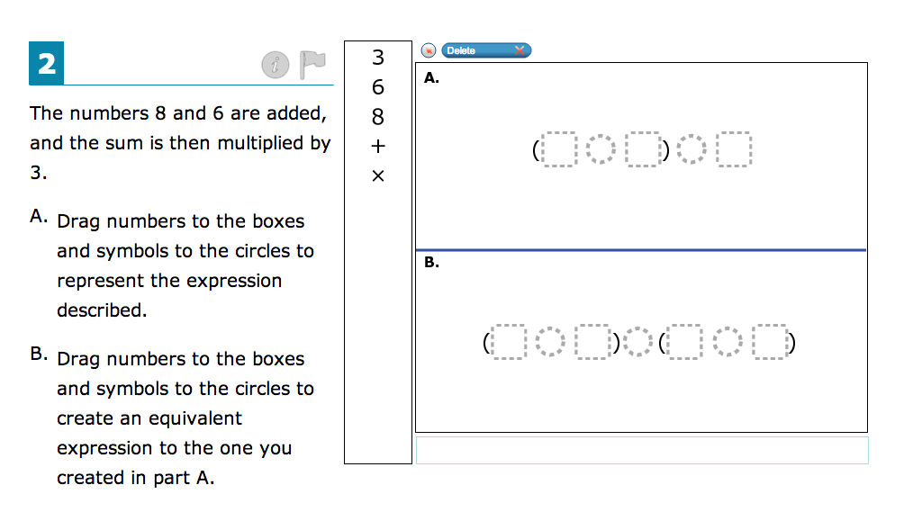
Drag and Drop!

Slide 15
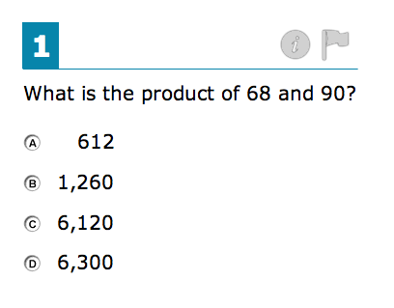
Single Answer Questions!

Slide 16
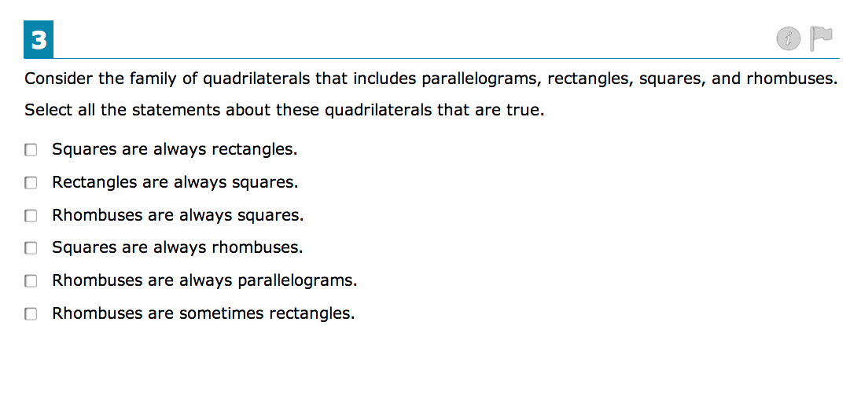
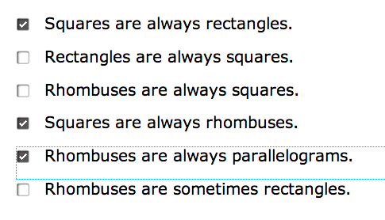
Multiple Answer Questions!

Slide 17
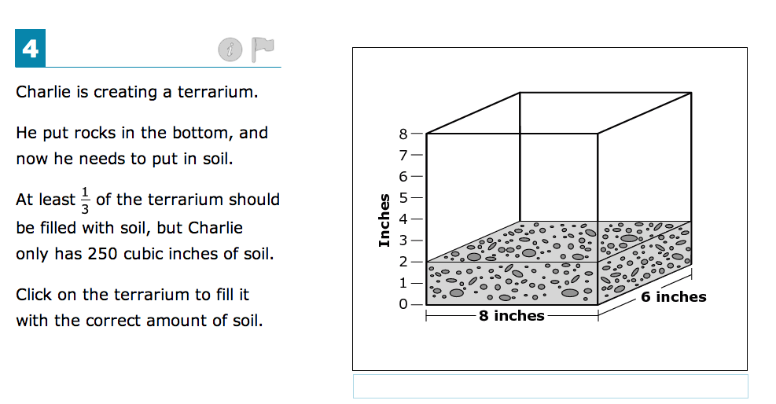
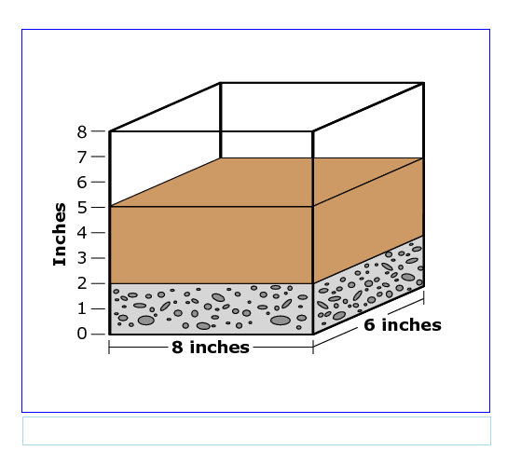
Interactive Questions!
Here you click on the terrarium and fill the tank.

Slide 18
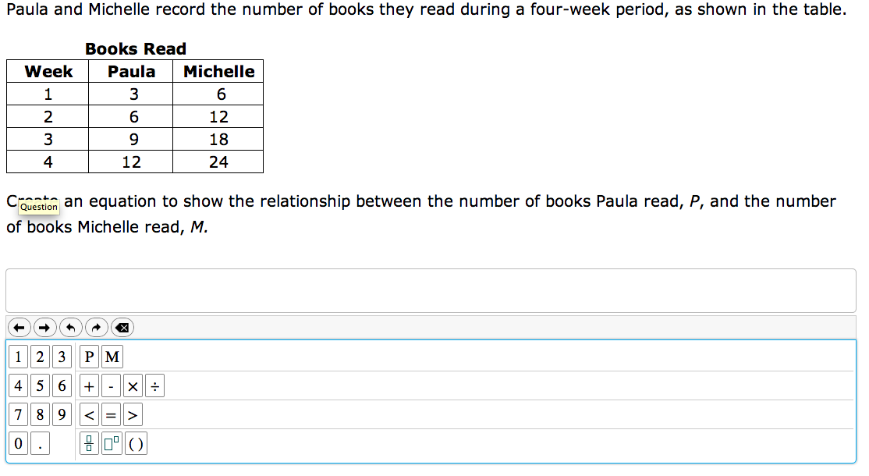
Choose and Click!
Notice the tools that are available:

Slide 19
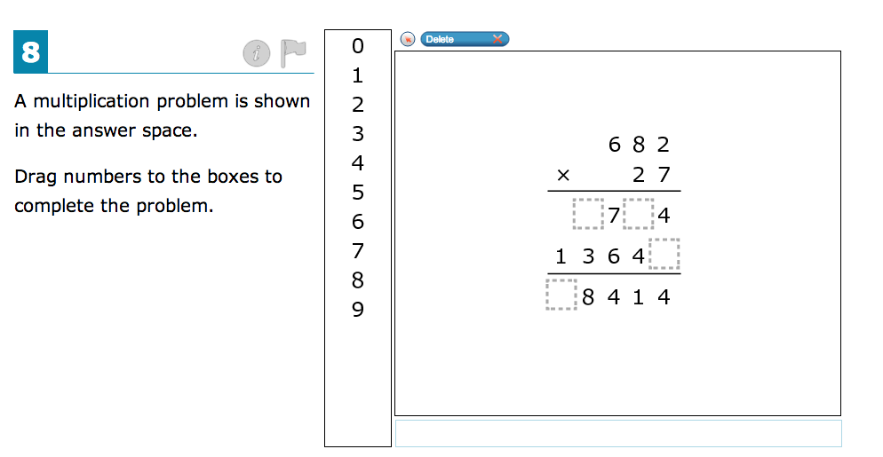
Drag and drop the numbers into the correct position.

Slide 20
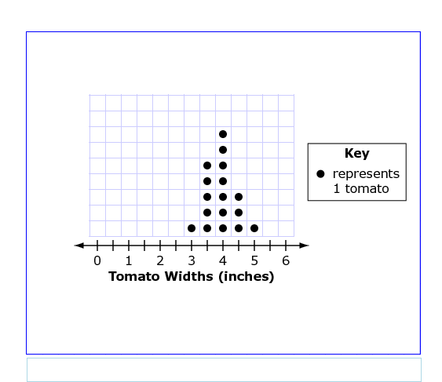
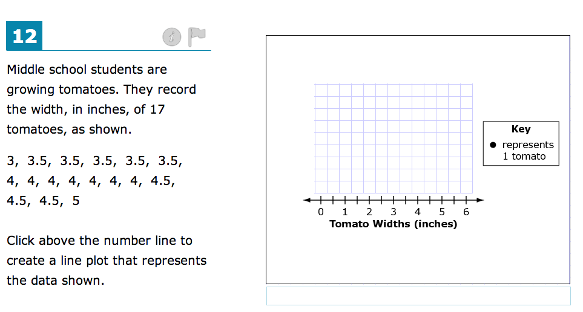
Click and plot the graph!

Slide 21
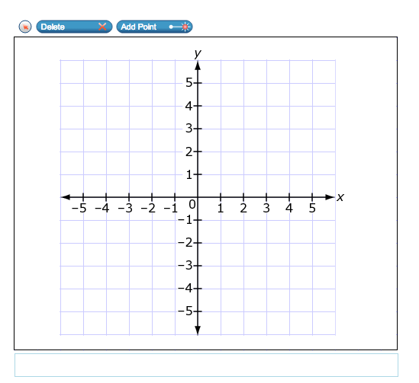
Click and plot a graph. Notice the “Delete” and “Add Point” Tools.

Slide 22
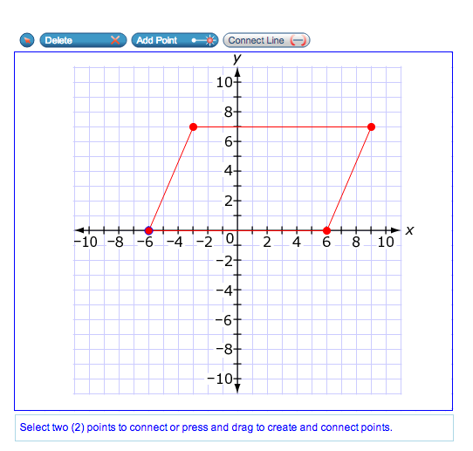
Another click and plot graph. Notice the “Connect Line” tool.

Slide 23
The Reading Test

Slide 24
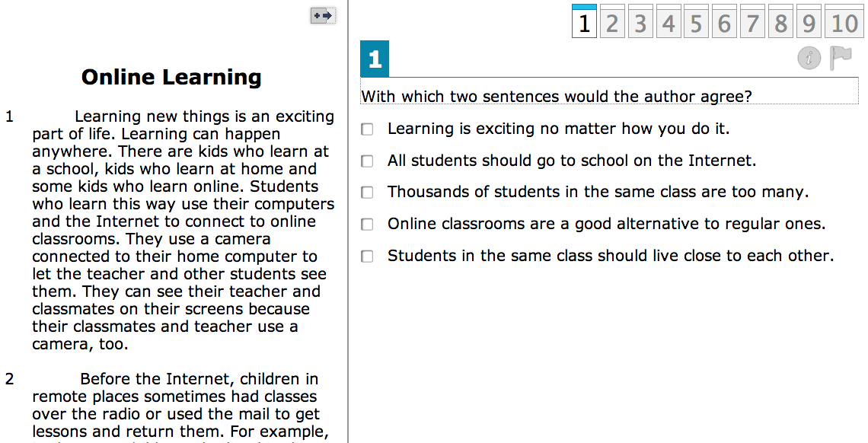
A couple of new things:
Question Map Bar (Use this to advance question groups) Once the group of questions are answered…hit next
Multiple answers

Slide 25
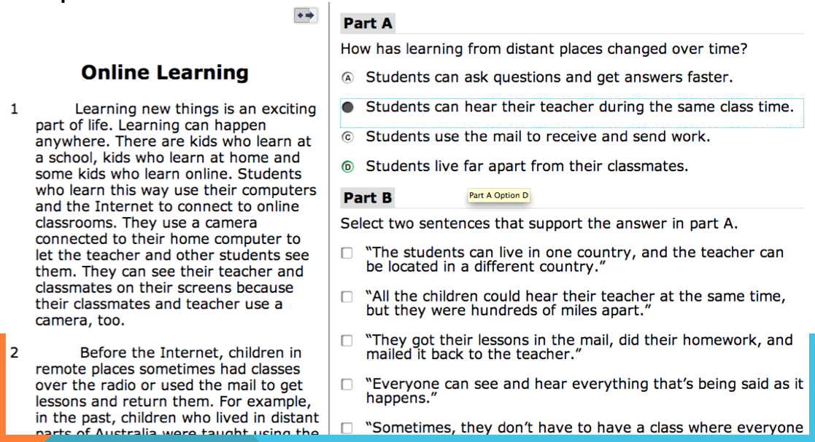
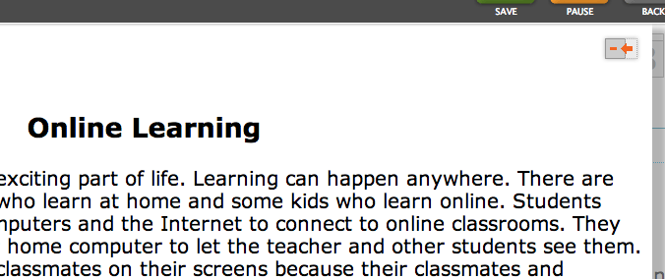
Maximize the passage by using the black arrow tool.
Click the red arrow
to return to the split
Screen.

Slide 26
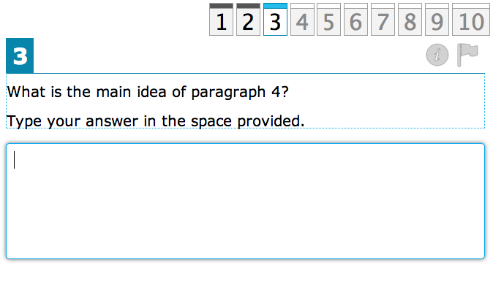
Short answer!

Slide 27
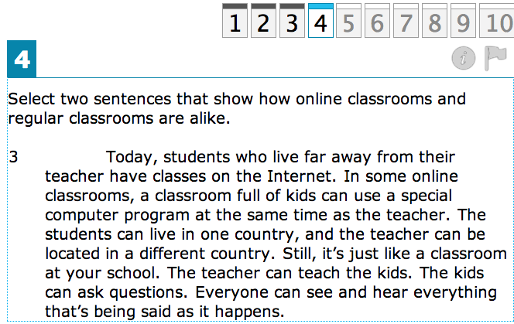
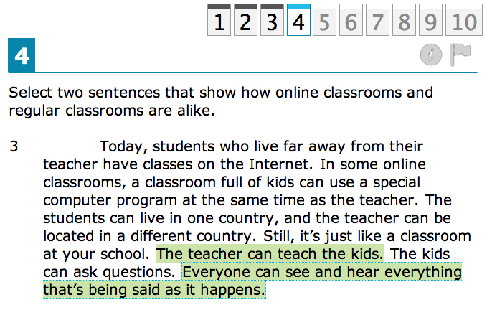
Click on single/multiple sentences to
highlight your answer.

Slide 28
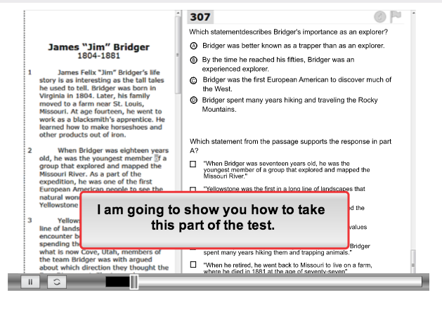
Notice the “Information” Tool

Slide 29
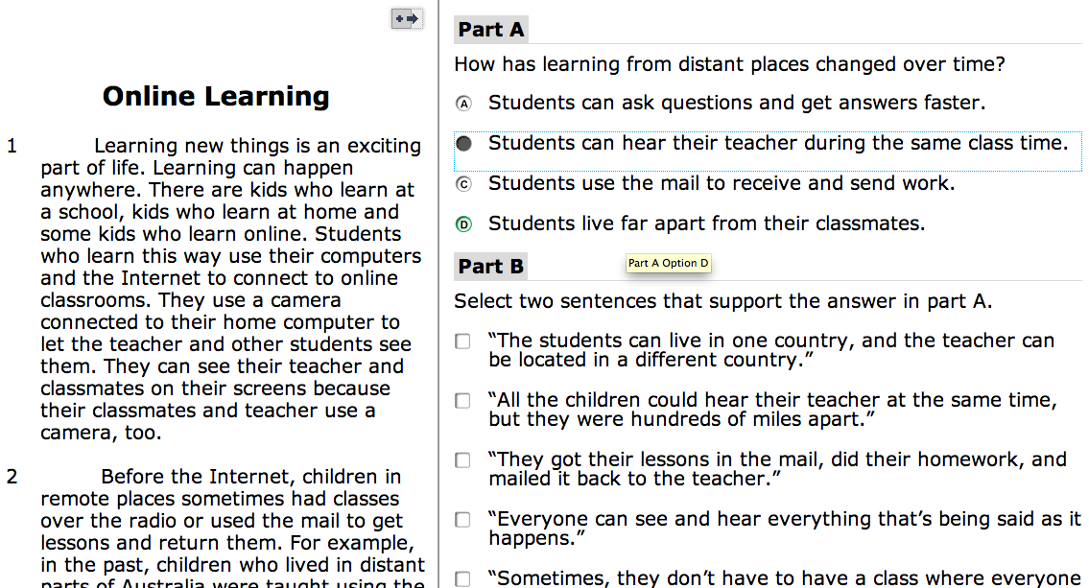
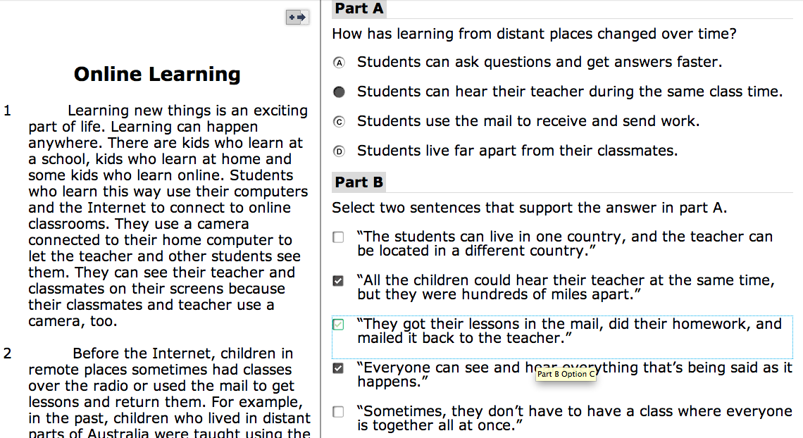
Don’t get tricked! Read the directions! Decide if a single or multiple answer is required.

Slide 30
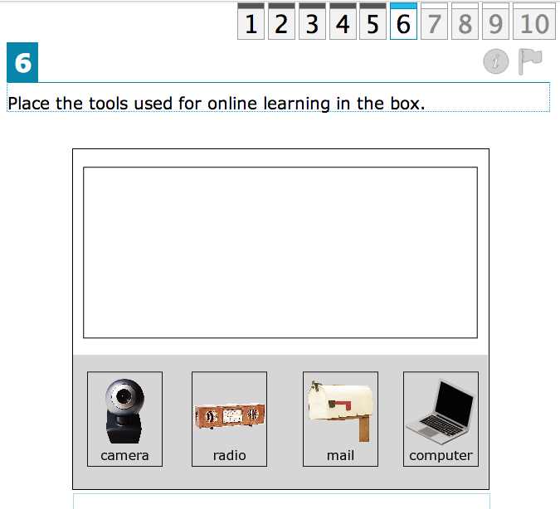
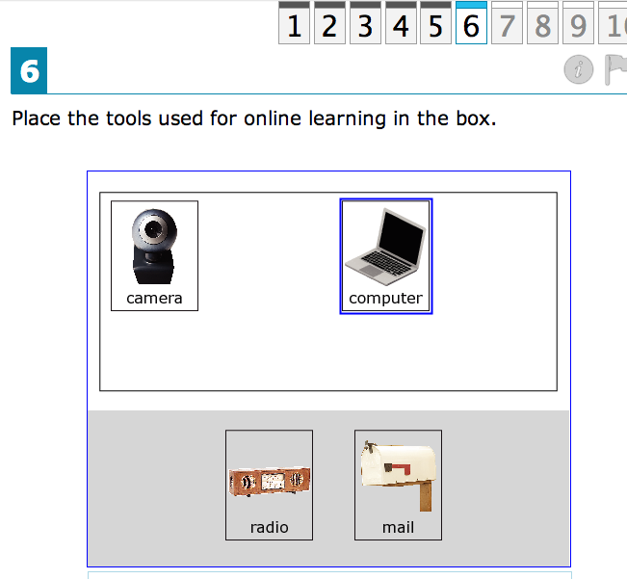
Drag and drop answers!

Slide 31
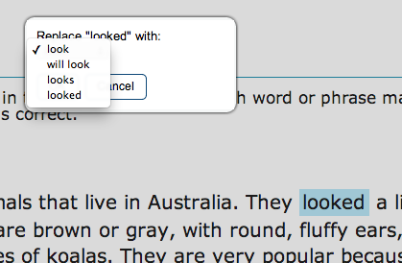
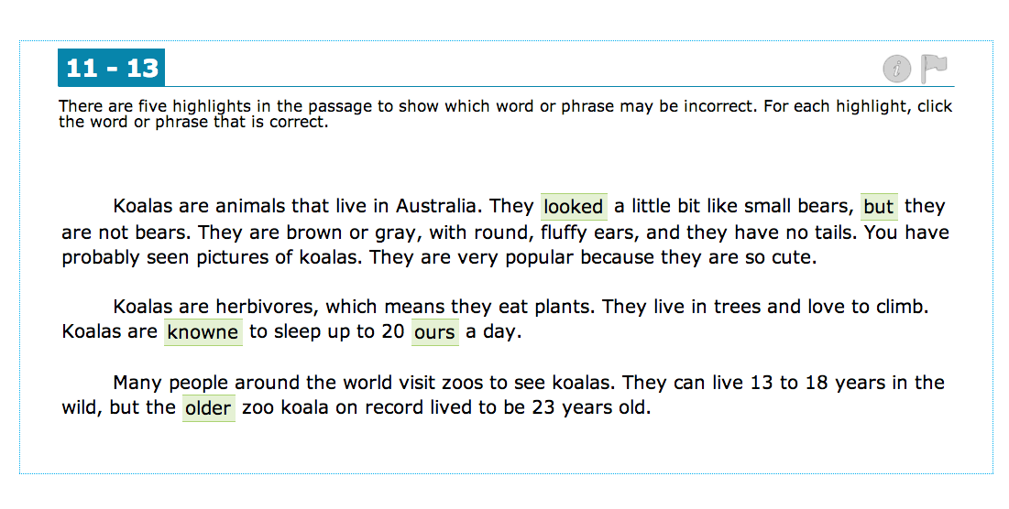
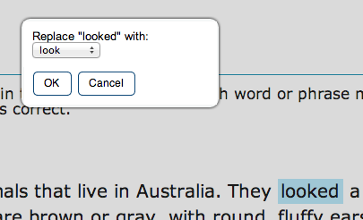
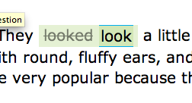
Dropdowns!

Slide 32
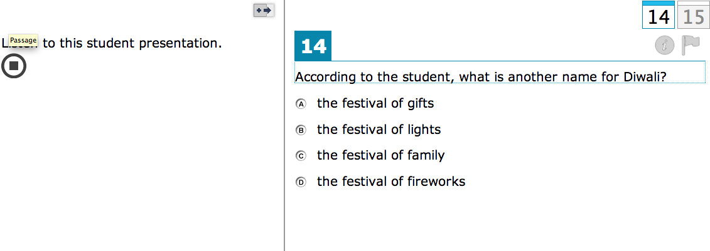
Listening Sections!
Suggestion: Look at the answers BEFORE listening to the passage. Make a shopping list in your brain for what you are looking for!

Slide 33
The Science Test!

Slide 34
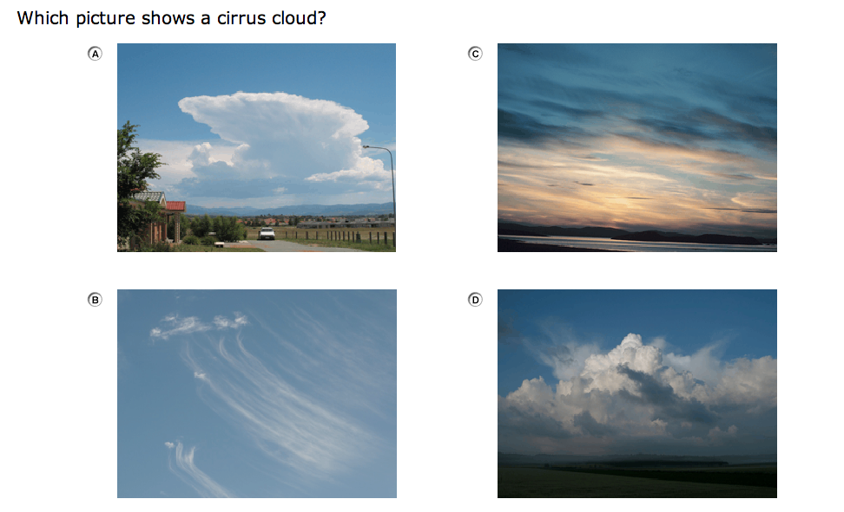
Graphics and Interactives are part of this year’s test! Pretty fun!

Slide 35
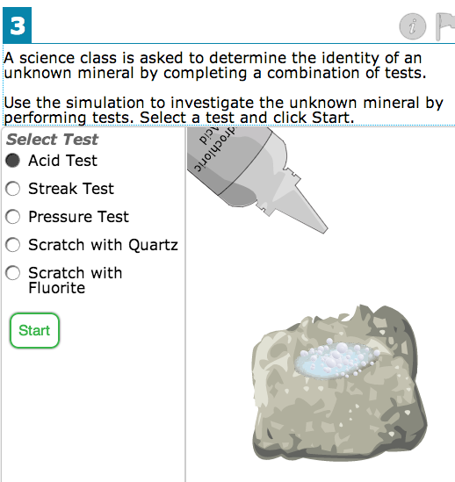
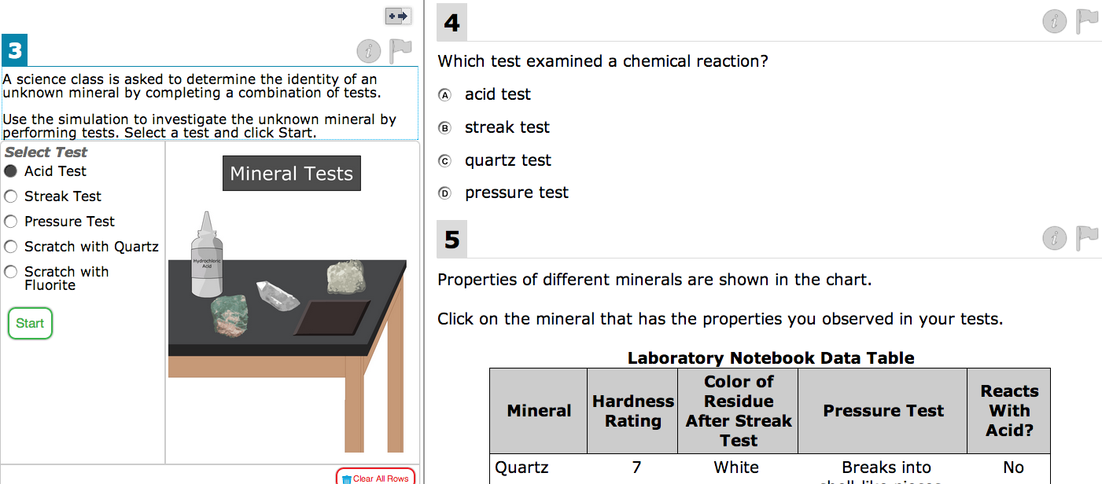
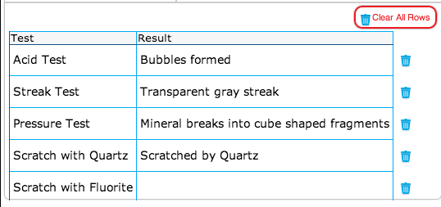
Multiple questions on one screen. Single and multiple answers are required, as well as clicking, dragging and dropping, and performing virtual experiments.

Slide 36
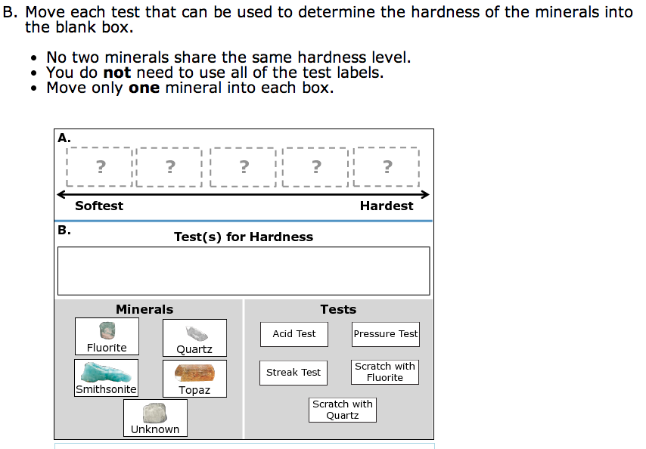
Drag and Drop!

Slide 37
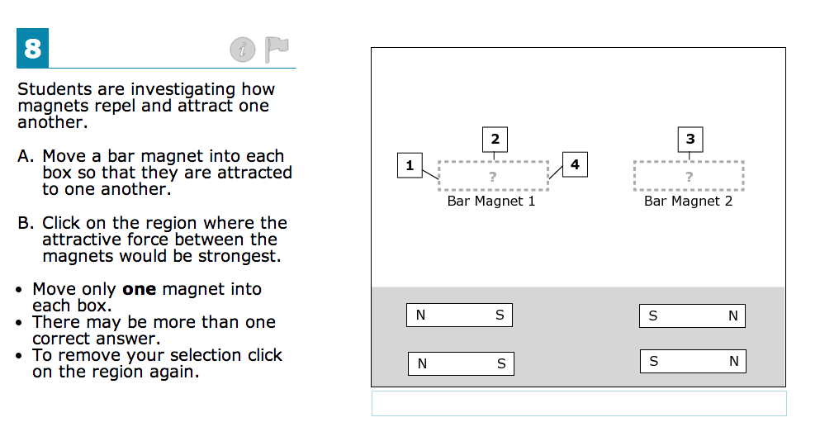
More Drag and Drop!

Slide 38
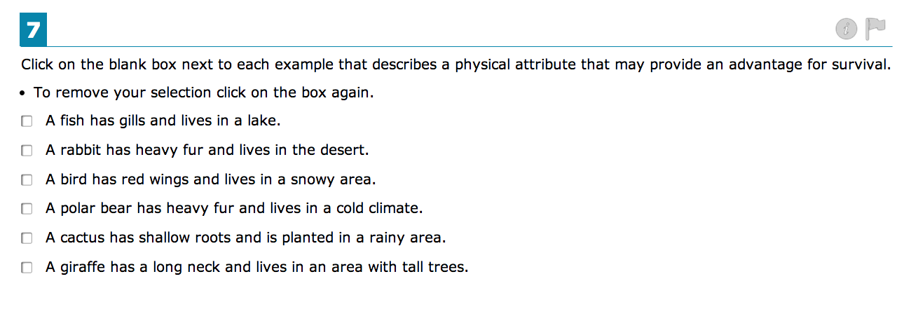
Multiple Answers!

Slide 39
Short Answer!

Slide 40
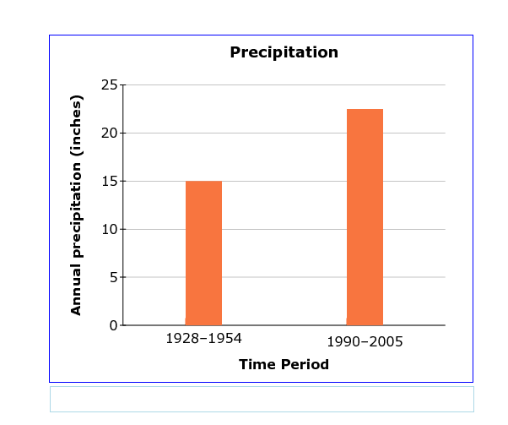
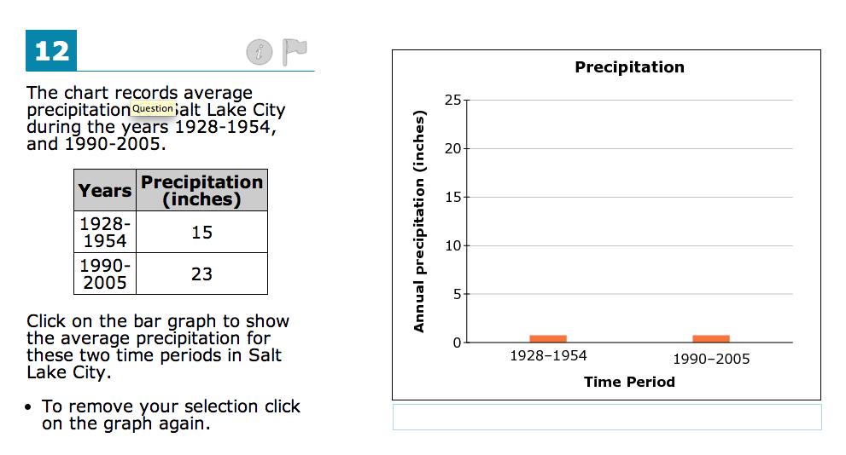
Click and Fill Graphs!

Slide 41
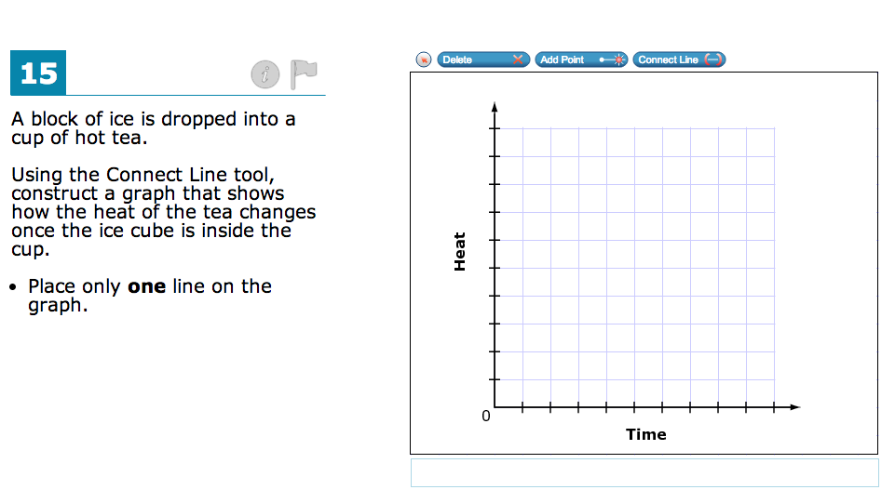
Plotting line graphs!
Do you remember the “Delete”, “Add Point”, and
“Connect Line” tools?

Slide 46
Time to Practice!
Good Luck!!

